Slide 1
Resp. Scientifico Antonino Granata Presidente del congresso Cosimo Callari
Weigt Regain o Insufficient Weigt Loss
Ruolo della Chirurgia: Ha ancora Senso ???
Marco D’Eletto
Roma, San Pietro FBF

Slide 2
Decision Making
Weight Regain > 25%
Insufficient Weight Loss < 50%
Persistence of Co-morbidities with adeguate weight loss
Persistence of Co-morbidities with weight Regain or insufficient weight loss.
No Guidelines for each individual case

Slide 3
Decision Making
No Guidelines for each individual case
Age patient
Emergence of new pathologies
Type of primary Surgery ( restrictive or malabsorptive)
Canghes on Eating Habits
Life Style changes
Multidisciplinary Assessment
Risks/ Benefits
Medical Therapy
Endoscopic Therapy
Surgery

Slide 4
Failure due to Anatomical or Patient causes
Non-responders groups

Slide 5
The 8th IFSO Registry Report showed an estimate that RBS accounts for 6.5% (n = 25,592) of all bariatric interventions (n = 480,970)
revisional bariatric surgery (RBS)

Slide 6
Revisional Bariatric Surgery
There is still no consensus on a revisional approach in cases of insufficient weight loss (IWL) or recurrence of obesity
The fact is that an RBS is generally a technically challenging procedure, with a higher risk of complications and debatable results, especially in the long term

Slide 7
Twenty-eight observational studies (n = 2213 patients) were included.
Follow-up > 2 years
Results
BMI
Twenty-three studies, covering 1602 patients, reported BMI values before and after RBS. Reduction of 10.2 points in BMI after at least two years of revisional procedure
%EWL
Eighteen studies (n = 1031 patients) assessed the percentage of excess weight lost after revisional surgery. The meta- analysis showed a loss of 54.8% of excess body weight after at least 2 years of revisional procedure
%TWL
Based on data from 16 studies with 888 cases, the reported mean percentage of total weight loss (TWL) was 27.2% after at least 24 months of the revisional procedure
Obesity Surgery (2024) 34:1917–1928

Slide 8
Insufficient weight loss
Worsening or development of de novo gastroesophageal reflux disease (GERD)
Persistence of associated complications such as type 2 diabetes mellitus (T2DM) and hypertension.
Prevalence of revisional bariatric surgeries 16.8 %
18,674 patients
The investigated revisional surgeries were
RYGB (in 13,249 patients)
Re‐Sleeve gastrectomy (re‐SG; in 1853 patients)
BPD/DS (in 1716 patients)
Single anastomosis duodenal‐ileal bypass (SADI; in 1021 patients),
OAGB (in 767 patients),
AGB (in 68 patients)

Slide 9
Major complications
re‐SG was associated with the highest rate of complications (13.1%)
Comorbidities remission
The remission and/or improvement of T2DM and hypertension, Dyslipidemia and OAS
meta‐analysis of the studies assessing co- morbidity remission revealed no statistically significant difference among different surgeries
Weight loss
% TWL 1 year SADI > OAGB- RYGB
End of FU OAGB-BPD/DS - SADI > RE-Sleeve
% EWL 1 year SADI > OAGB
End of FU SADI > RYGB-OAGB-Re-Sleeve

Slide 10
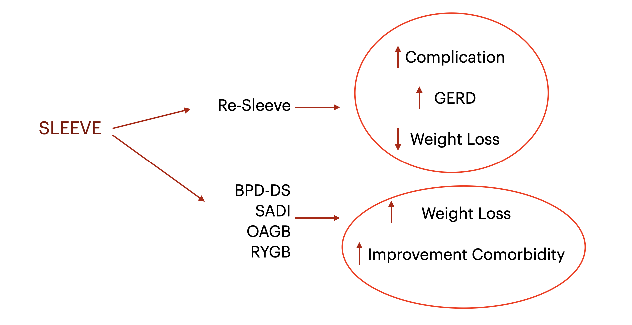
…. “One critical reason for the failure of gastric sleeves is the improper indication for the procedure”……

Slide 11
5% to 35% of patients experience inadequate weight loss (IWL) or weight regain (WR) after RYGB
Preoperative factors associated with WR and IWL include a high initial body mass index (BMI), personality disorders, presence of type 2 diabetes, and old age
Postoperative predisposing factors are loss of follow-up, metabolic and hormonal imbalance, psychiatric comorbidities and use of psychiatric drugs
Causes associated with anatomy are dilated gastro-jejunal anastomosis (GJA), enlarged gastric pouch and gastro-gastric fistula

Slide 12
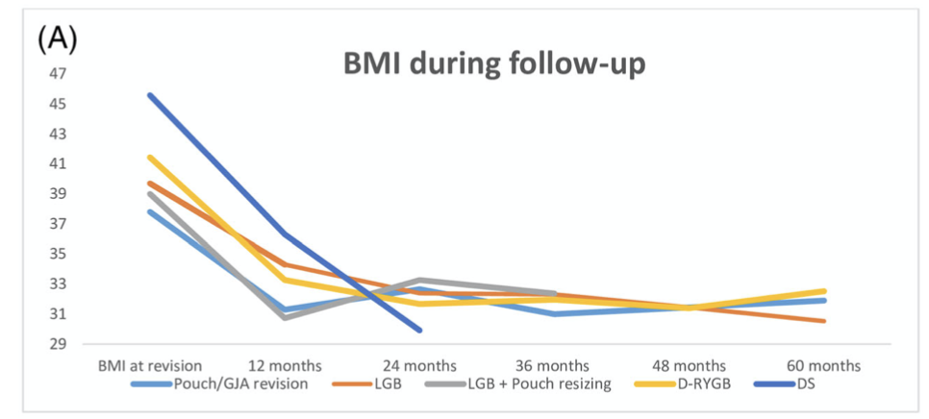
Re-Do
Pouch/gastro-jejunal anastomosis (GJA) revision
Laparoscopic gastric banding (LGB)
LGB + pouch resizing
Distalization of the Roux-en-Y gastric bypass (D-RYGB)

Slide 13
Results
Pouch/GJA revision
LGB + pouch resizing
% TWL was 21.2 and 17.0 after 12 and 36 months
A total of 13 reoperations (17.3%) were reported, of which 10 band were removals (13.3%)
%TWL was 17.2 - 13.6 - 18.0 and 15.6 after 12, 24, 36, and 60 months, respectively
D-RYGB
LGB
%TWL was 19.7 - 23.6 - 22.9 -24.2 and 21.5 after 12, 24, 36, 48, and 60 months, respectively.
Complications were reported in 225 patients (51.8%).
Reoperations were described in 91 cases (21.0%), of which 65 were undo procedures (15.0%)
%TWL was 13.6 - 18.4 - 18.6 - 20.8 and 23.1 after 12, 24, 36, 48, and 60 months, respectively

Slide 14
Combination of LGB and pouch resizing led to a %TWL of 21.2 and 17 after 12 and 36 months, respectively
D-RYGB showed a %TWL of 19.7 and 21.5 after 12 and 60 months, respectively.
Conclusion
Severe nutritional deficiencies were reported in 18% of cases
Pouch or GJA revision was effective on short term follow-up.
Percentage TWL was 17.2 after 12 months and remained 15.6 after 60 months.
Complications were anastomotic leakage (6%) and GI-stenosis (3.4%)
Surgical techniques are effective on short and mid-term but are associated with high complication rates.
LGB was effective as a revisional procedure with a %TWL of 13.6 and 23.1 after 12 and 60 months, respectively.
In case a pouch or GJA is dilated, a restrictive procedure is advisable.
In case of a normal pouch or GJA, a malabsorptive procedure could be the treatment of choice.
In this study, durable weight loss was found.
It is hypothesized that additional placement of a ring prevents long-term WR due to dilatation of the gastric pouch.

Slide 15
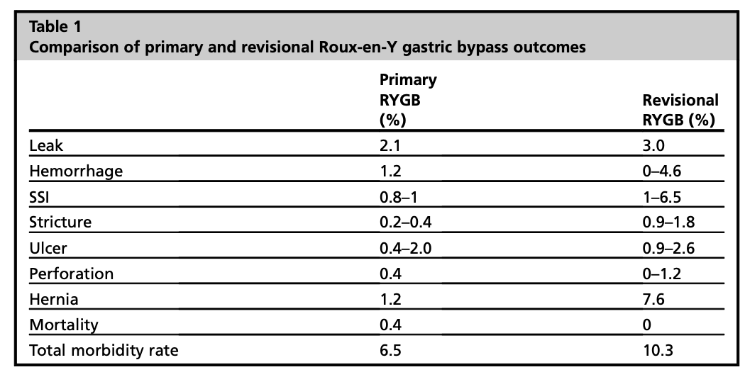
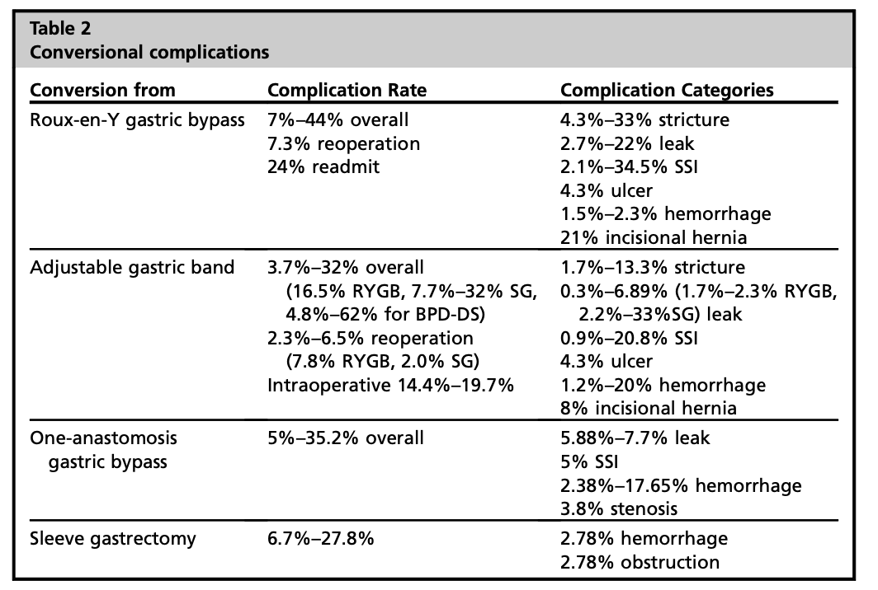
Conversional Complication

Slide 16
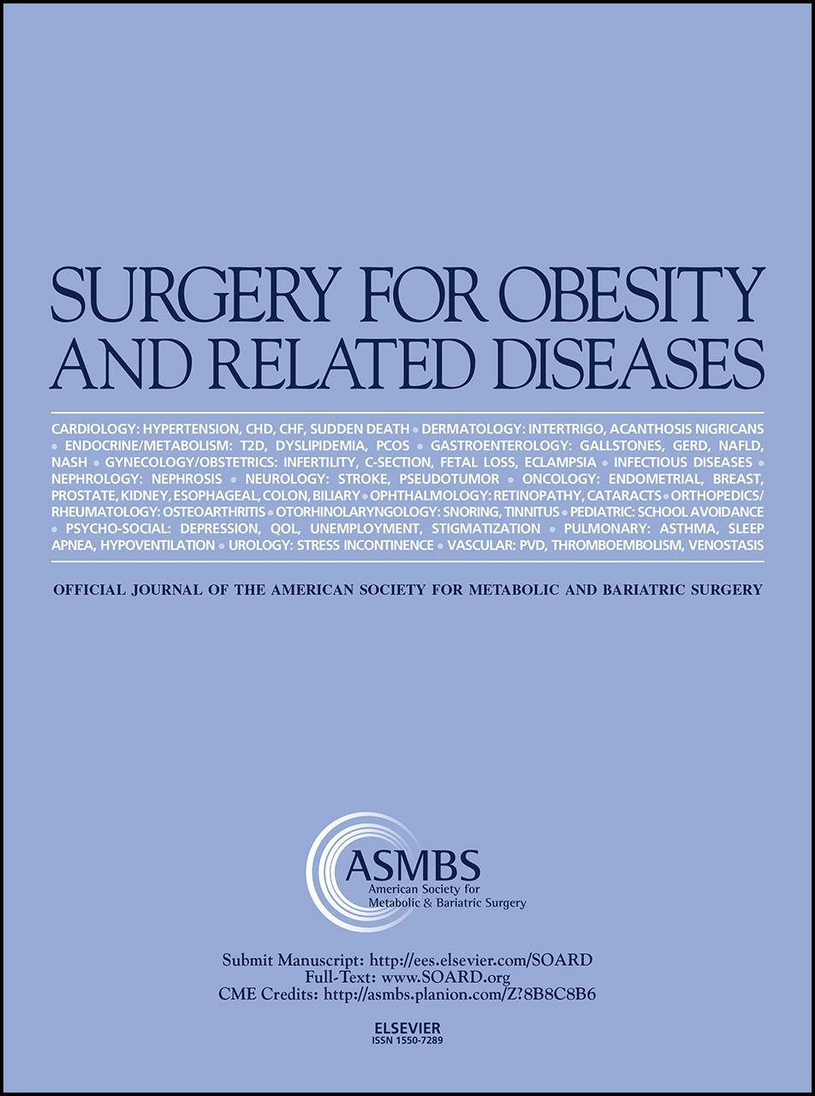
Metabolic Outcomes
The aim of this study is to review existing literature on the effects of revisional bariatric surgery on obesity-related co-morbidities such as T2D, hypertension (HTN), hyperlipidemia (HLD) and OSA
Nevertheless, there remain a proportion of patients in which there is a Persistence of obesity related co-morbidities following primary bariatric surgery despite adequate weight loss.
There are indeed studies that demonstrate a positive effect of revisional surgery on obesity-related co-morbidities and support its use for the management of recurrent or refractory diseas

Slide 17
Results
Metabolic Outcomes
Improvement and Remission in T2D
meta-analysis showed
92.0% (95% CI: 85.0% to 97.0%) improvement in T2D and 50.0% (95% 220 CI: 37.0% to 63.0%) remission in T2D
Improvement and Remission in HTN
meta-analysis showed
81.0% (95% CI: 70.0% to 90.0%) improvement in HTN and 33.0% (95% CI: 22.0% to 45.0%) remission of HTN
Remission in HLD
meta-analysis showed
37.0% (95% CI: 21.0% to 55.0%) remission of HLD
Improvement in OSA
meta-analysis showed
86.0% (95% CI: 73.0% to 96.0%) improvement in OSA

Slide 18
Ruolo della Chirurgia: Ha ancora Senso ???
Resp. Scientifico Antonino Granata Presidente del congresso Cosimo Callari
Conclusion
There are indeed studies that demonstrate a positive effect of revisional surgery on obesity-related co-morbidities and on Weight regain and support its use for the management of recurrent or refractory diseas
Surgical techniques are effective on short and mid-term but are associated with high complication rates.
No Guidelines for each individual case
Multidisciplinary Assessment is necessary

